Slide 1
Mercury: Detecting the Performance Impact of Network Upgrades
Ajay Mahimkar, Han Hee Song* , Zihui Ge, Aman Shaikh,
Jia Wang, Jennifer Yates, Yin Zhang* , Joanne Emmons
AT&T Labs – Research * UT-Austin
ACM SIGCOMM 2010, New Delhi, India

Slide 2

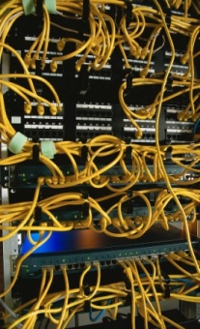











Increasing Network Complexity
Immense software complexity
Scale, Bugs, Interactions
Massive scale
100s of offices, 1000s of routers,
10,000s of interfaces,
Millions of consumers
Applications
Scale, sensitivity
Diverse technologies and vendors
Layer-1, Layer-2, Switches, Routers,
IP, Multicast, MPLS, wireless access points
Continuous evolution
Upgrades, Installations

Slide 3

What are Network Upgrades?
Fundamental changes to the network
Router software or hardware upgrades
Configuration and policy changes
Upgrades can result in unpredictable impacts in performance
Impacts might fly under radar
Goals
Introduce new service features
Reduce operational cost
Improve performance
packet loss
Enterprise
System
Servers
End Users
Operator
Notes:
Expected changes: e.g., software upgrades lead to improvement in router CPU utilization
Unexpected changes: e.g., performance degradation caused by bugs in the new release of software

Slide 4
Monitoring Impact of Upgrades
One aspect: extensive lab testing before deployment
Software engineering principles and certification process
Goal is to prevent bugs from reaching the network
Problems with lab testing
Cannot replicate scale and complexity of operational networks
Cannot enumerate all test-cases
Important to monitor upgrades in-field
Manual investigation: critical issues are caught after a long time
Operations Challenge: Large number of devices and performance event-series
Innovative solutions required to monitor at scale

Slide 5
Mercury
Detects the performance impact of upgrades in operational networks
Automated data mining to extract trends
Scalable across a large number of measurements
Flexible to work across a diverse set of data sources
Ease of interpretation to network operations
Challenges
How to extract upgrades?
Do upgrades induce behavior changes in performance?
Is there commonality in configuration across devices?
Is the change observed network-wide?

Slide 6
Extracting upgrades
Minimize dependency on domain expert input
Human information can be unreliable, incomplete, or outdated
Our approach is data-driven: mine configuration & workflow logs
Operating system upgrades
Track OS version and upgrades using polling
Firmware upgrades
Detect difference in hardware configuration across days
Upgrade-related configuration changes
Lots of configuration changes
Frequent changes like provisioning customers are not upgrades
Heuristic: look for “out of the ordinary”
Two metrics: high coverage (skewness) and rareness

Slide 7
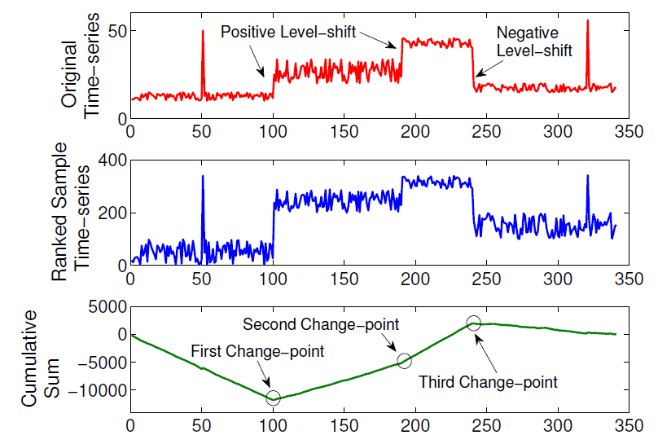
Detecting Upgrade Induced Changes
Performance event-series creation
Divide each series into equal time-bins
For example, daily counts or averages
Behavior change detection
E.g., a persistent level-shift
Changes in means, medians, standard deviations or distributions
Our Approach:
Recursive Rank-based Cumulative Sums (CUSUM)
Outputs significant changes along with magnitude (positive versus negative)
U₁
U₂
Upgrades
Associating changes to upgrades
Proximity Model: Same location and close in time
CUSUM S_{i} = S_{i-1} + (r_{i} – ŕ)
S₀ = 0

Slide 8
Identifying commonality
Extracting common attributes helps drill-down into changes
Software configuration
Example attributes are OS version, number of BGP peers, re-routing policies
Device location, role, model, vendor
Problem: Identifying common attributes is a search in a multi-dimensional space
Classical machine learning problem
Solution: RIPPER rule learner
Outputs rules of form A => B
E.g., if (upgrade = OS change) and (router role = border)
=> positive level-shift in CPU
Change
Upgrade
Attributes
A₁
A₂
. .
A_{n-1}
A_{n}
+
-
.
.
+

Slide 9
Detecting Network-wide Changes
Why network-wide change detection?
Changes might be missed for rare events at each device
Aggregation across devices increases the change significance
How to aggregate event-series for each upgrade type?
For each event-series, identify devices that are upgraded
Not trivial to simply aggregate - each upgrade applied over several days
Solution: Time alignment for each upgrade
Align event-series such that upgrade falls on same date
Upgrade date
Upgrade date
Significant Change
after aggregation
R₁
R₂
R₃

Slide 10
MERCURY Evaluation
Evaluation using real network data is challenging
Lack of ground truth information
Close interaction with network operations
Data Sets
Upgrades: router configuration, workflow logs
Performance event-series: SNMP (CPU, memory) and syslogs
Collected from tier-1 ISP backbone over 6 months
Number of routers = 988
Router categories: core, aggregate, access, route reflector, hub
Notes:
Our approach: Close interaction with operators
Validation using operators’ domain knowledge
Experience using case studies

Slide 11
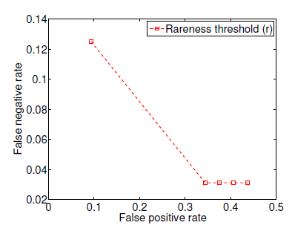
Extracting Upgrades
Compare Mercury output with labels from operations
False positive: falsely detected by Mercury
False negative: missed by Mercury
Vary the threshold for detecting rare upgrade-related configuration changes
r = 2
r = 6
r = 4
r = 10
r = 8
r = 4
MERCURY Output
Upgrade Labels from Operations | Counts | MERCURY Labels | Counts
Interesting | 13 | False negative | 1
Non-interesting | 19 | False positive | 11
Filtered after applying behavior change detection

Slide 12
Upgrade induced Behavior Changes
Router Role | Core Routers | Aggregate Routers | Access Routers | Route Reflectors | Hub Routers | Total
Performance series | 103,112 | 43,226 | 113,079 | 6,548 | 24,095 | 290,060
MERCURY Output
Performance Event-series | Count | Upgrades | Upgrade Event-series Pairs | Upgrade induced change-points | Unique Cases
CPU | 988 | 185 | 182,780 | 338 | 10
Memory | 988 | 185 | 182,780 | 160 | 4
Syslogs | 288,084 | 185 | 53,295,540 | 3181 | 92
Significant reduction
MERCURY not only confirmed earlier findings,
but also revealed previously unknown network behaviors

Slide 13
Mercury Findings Summary
Operating system upgrades
Downticks in CPU utilizations on access routers
Upticks in memory utilizations on aggregate routers
Varying behaviors in layer-1 link flaps across different OS versions on access routers
Upticks in number of protection switching events on access routers
Firmware upgrades
Downticks in CPU utilizations on central CPU and customer-facing
Upticks on optical carrier line cards
BGP fast external fall-over policy changes
Upticks in the number of “down interface flaps”
Downticks in the number of BGP hold timer and peer closed session events

Slide 14
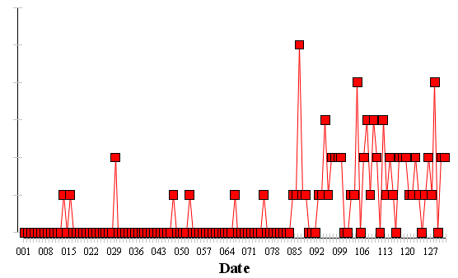
Case Study: Protection Switching
Line card protection in access routers
To protect customers from line card failures
On failure, customers are switched to backup
Switching is called Automated Protection Switching (APS)
OS upgrade
MERCURY validated a known issue
Small increase in the frequency of APS failure events
Critical issue impacting customers
Run across all the syslog messages
APS failure events are rare per router
Statistically indistinguishable on an individual router level
Change detected when aggregated across all upgraded access routers
Mercury was used by Ops to track improvements as fix was deployed
Dates normalized across all upgraded routers. The upgrade happened on day 84

Slide 15
Conclusions
Mercury detects persistent changes in performance induced by upgrades
Automated detection with minimal domain knowledge
Scalable to a large number of measurements
Flexible to be applied across diverse data sources
Operational Experiences
Confirmed earlier findings as well as discovered previously unknown behaviors
Is becoming a powerful tool inside AT&T
Future Work – Lots !!!
Apply Mercury to new domains such as data centers, VoIP, IPTV, Mobility
Behavior changes induced by chronic events
Real-time capabilities

Slide 16

Thank You !

